Slide 1
Scientific Method – Review Unit 1

Slide 2
Scientific Method - Review
Hypothesis
Controlled Experiment
Data
Conclusion
Theory
Law

Slide 3
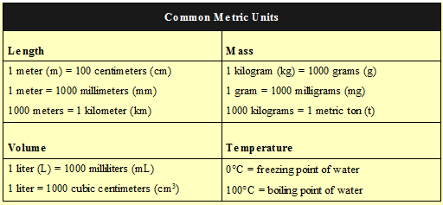
Scientific Method - Review

Slide 4
Scientific Method
1. Which is included in the definition of a scientific theory?
A well- tested explanation of natural events
A statement of what most people believe to be true
A description of natural events based on casual observations
A conclusion agreed upon by people without experimentation

Slide 5
Scientific Method
2. What must be true of theories before they are accepted by the scientific community?
Practical applications must be suggested.
Similar explanations must be in existence.
They must be supported by empirical data.
Experiments must be conducted to refute the idea.

Slide 6
Scientific Method
3. Why are ethics important in science?
Provides interesting topics to study
Keeps research within moral boundaries
Allows controversial issues to be resolved
Reflects the values of everyone in the community

Slide 7
Scientific Method
4. A scientist develops a new strain of corn. She then receives a large grant from the government to determine how well the new corn grows. She is also responsible for choosing where the new strain of corn will be grown and collecting data on its growth and yield. When the study is completed, she will also write the final report. Which is the most likely source of bias in this experiment?
The scientist grows the corn in fertile soil.
The scientist does not grow any corn because of drought.
The scientist may take too much time to finish the report.
The scientist is making conclusions about a product that she developed.

Slide 8
Scientific Method
5. Which is an example of applied science?
Formulating the cell theory
Developing new medicines
Generating hypotheses on the origin of life
Discovering the law of independent assortment

Slide 9
Scientific Method
6. Why is a peer review important to the acceptance of a theory?
Determines when the theory can be modified
Confirms that the theory is scientifically sound
Explains how the theory can be proven in the future
Evaluates if the theory can be applied to other explanations

Slide 10
Scientific Method
7. Which statement is true of the ethical parameters used by scientists?
Used only for studies involving new medicines
Used only for research projects involving animals
Used to prevent researchers from paying their subjects
Used to prevent unnecessary suffering or harm to all organisms

Slide 11
Scientific Method
8. A bird- watcher records the movement of migrating birds. In which part of the scientific process is the bird- watcher participating?
Controlling variables
Experimenting
Observing
Hypothesizing

Slide 12
Scientific Method
9. Based on your observations, you suggest that the presence of water could accelerate the growth of bread mold. This is
A conclusion
A hypothesis
An experiment
An analysis

Slide 13
Scientific Method
10. A student sees a bee on a flower. The student wonders how the bee finds flowers. This student is displaying the scientific attitude of
Creativity
Curiosity
Open-mindedness
Skepticism

Slide 14
Scientific Method
11. A theory
Is always true
Is the opening statement of an experiment
May be revised or replaced
Is a problem to be solved

Slide 15
Scientific Method
12. How do scientific theories compare to hypotheses?
Theories are the same as hypotheses
Theories unify a broad range of observations and hypotheses
Hypotheses combine the ideas of several theories to explain events
Hypotheses are the dominant view among scientists

Slide 16
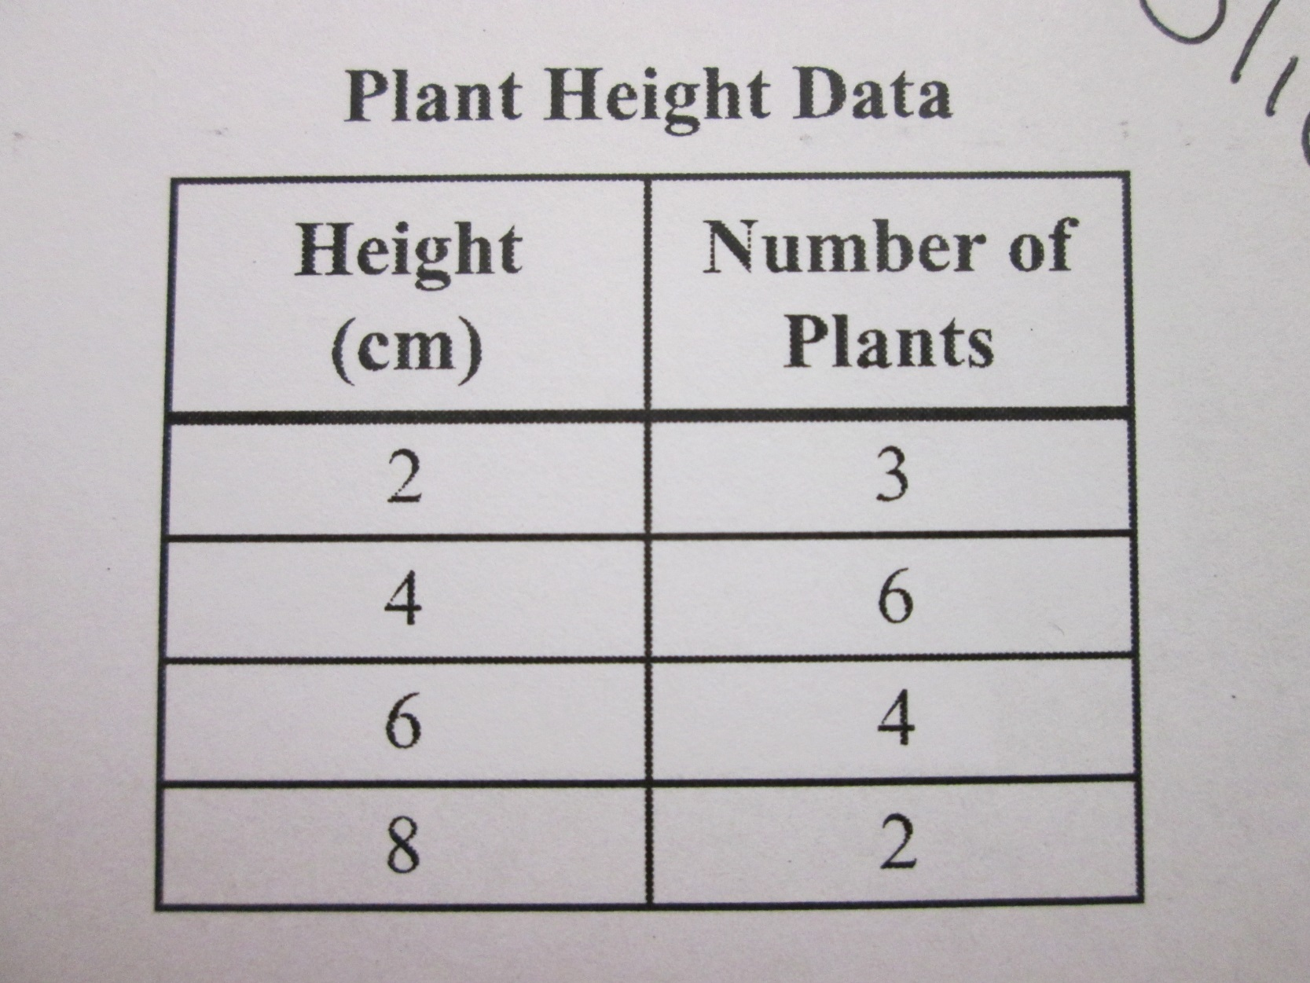
Scientific Method - Data
13. What is the mode in this set of data?
4
8
15
20

Slide 17
Scientific Method - Data
14. 425milligrams equals how many grams?
42.5 g
4.25 g
0.425 g
0.0425 g

Slide 18
Scientific Method - Data
15. 250 centimeters equals how many meters?
25.0 m
2.50 m
0.25 m
0.025 m

Slide 19
Scientific Method - Data
16. Which would be the best conditions for algae to undergo photosynthesis?
Temperature around 20°C with a light intensity of 50 lux
Temperature around 40°C with a light intensity of 250 lux
Temperature around 60°C with a light intensity of 125 lux
Temperature around 100°C with a light intensity of 250 lux
See next slide

Slide 20
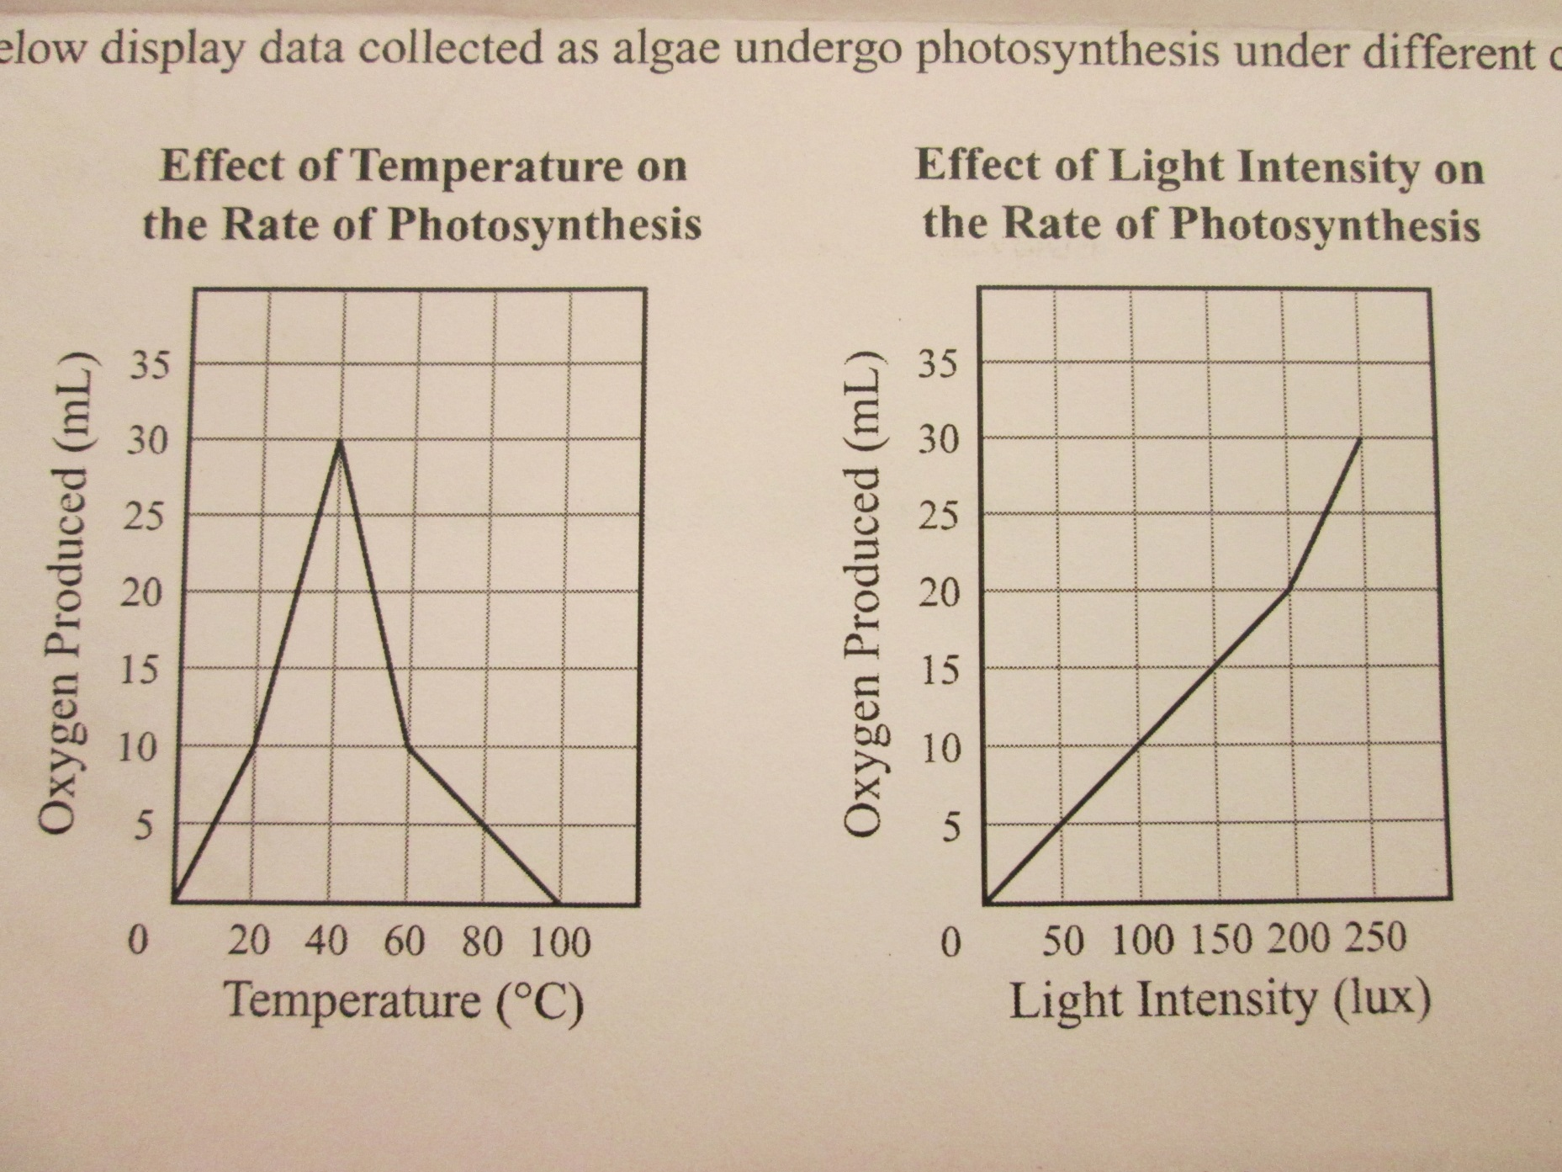
Scientific Method – Data – 16

Slide 21
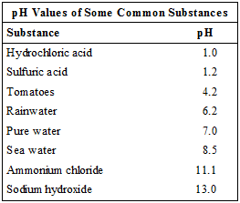
Scientific Method - Data
17. What is the strongest base listed on the table ?

Slide 22
Scientific Method - Data
18. At what temperature in ºC does water boil?

Slide 23
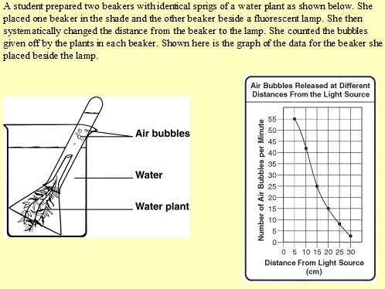
Scientific Method - Data

Slide 24
Scientific Method - Data
19. Which beaker is the student’s control?
20. At what distance from the light source was the greatest number of bubbles produced?

Slide 25
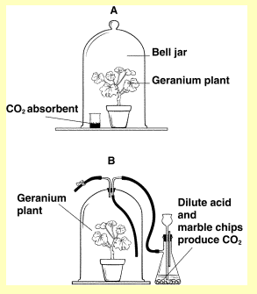
Scientific Method - Data

Slide 26
Scientific Method - Data
21. What factor is the student testing?
22. What would be an appropriate control for this experiment?
23. Write a hypothesis for this experiment.

Slide 27
Scientific Method - Data
24. What are four common metric units used to measure length?

Slide 28
Scientific Method - Data
25. At approximately what temperature in ºC is room temperature?

Slide 29
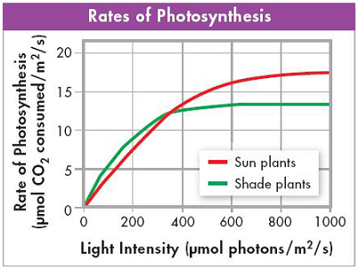
Scientific Method - Data
26. MODIFIED TRUE OR FALSE: According to the graph, the rate of photosynthesis in shade and sun plants decreases and then levels off as light intensity increases.

