Slide 1
Chemistry & Cells – Review Unit 2

Slide 2
Chemistry - Review
List the 4 organic compounds responsible for building all living organisms.
____________________
____________________
____________________
____________________

Slide 3
Chemistry - Review
Fill in the table below:
COMPOUND | ROLE/FUNCTION
 | Transport, immune system, catalysts
CARBOHYDRATE
 | Store / transmit genetic information
LIPID

Slide 4
Chemistry - Review
Compare the terms listed below:
Reactant – product
Protein – enzyme – catalyst
Substrate – active site
Chemical reaction – activation energy
Homeostasis – metabolism

Slide 5
Chemistry
1. During strenuous exercise, the body temp increases. The body responds to the increase in temp by sweating, which helps to reduce the body temp. Which is demonstrated in this situation?
Excretion
Metabolism
Homeostasis
Synthesis

Slide 6
Chemistry
2. Which describes the relationship in the shape between an enzyme and a substance?
Competitive
Regenerative
Symmetrical
Complementary

Slide 7
Chemistry
3. What name is given to the condition of stability enabled by a set of processes such as those involved in the maintenance of internal body temperature?
Respiration
Metabolism
Homeostasis
Metamorphosis

Slide 8
Chemistry
4. What type of organic molecules are enzymes?
Carbohydrates
Lipids
Nucleic Acids
Proteins

Slide 9
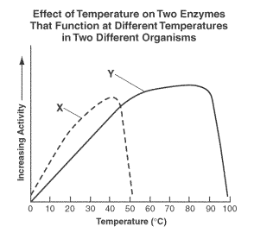
Chemistry
5. Which enzyme would you expect to find in a bacterium growing in a hot spring?

Slide 10
Chemistry
6. What type of molecule do whales use for energy storage and insulation?
DNA
Glucose
Fat
Starch

Slide 11
Chemistry
7. Which is a property of water?
The water molecule is non polar.
Solid water is denser than liquid water.
Water molecules repel other water molecules.
Water has the ability to dissolve many different substances.

Slide 12
Cells & Cell Transport - Review
There are two types of eukaryotic cells, they are _________ and _________.
All living organisms are composed of _________.
3. Using a “T chart” show the differences and similarities between a plant and animal cell.

Slide 13
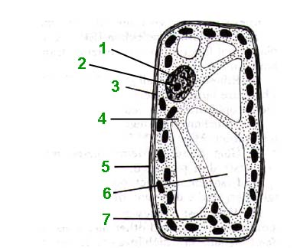
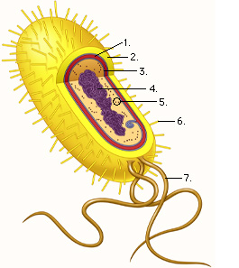
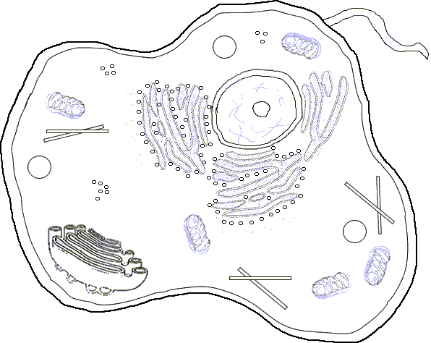
Cells & Cell Transport - Review
Label each cell as Eukaryotic or Prokaryotic
Label each cell as Bacteria, Animal or Plant
Label the distinguishing features of the cell that helped you identify its cell type.

Slide 14
Cells & Cell Transport - Review
In this figure the selectively permeable membrane only allows Molecule D to move across the membrane. Predict which direction molecules will move and how many molecules will move across the selectively permeable membrane to maintain homeostasis.
Direction molecules D will move? ___________________________
How many molecules will move? __________________________
Number of molecule D on each side? _________________________

Slide 15
Cells & Cell Transport - Review
A cell has a 68% salt concentration. It is put into a solution with a 32% salt concentration.
What type of solution is this?
(Hypotonic, Hypertonic, Isotonic)
A cell has a 43% salt concentration. It is put into a solution with a 57% salt concentration
Will water move into the cell, move out of the cell or have no net movement?
A cell is placed into a solution. After one hour, the cell has not expanded or shrank.
What type of solution was the cell put in? Hypotonic, Hypertonic or Isotonic

Slide 16
Cells & Cell Transport - Review
Cell Membrane: Using the diagram complete the chart about the processes of Passive and Active Transport.
 | Uses Energy? | Direction Molecules Move?
Passive Transport
Active Transport

Slide 17
Cells & Cell Transport
8. A freshwater plant is placed in a container of saltwater. What is most likely happen to the cells of the plant?
They will swell because water will move into them.
They will swell because salt will move into them
They will shrink because water will move out of them.
They will shrink because salt will move out of them.

Slide 18
Cells & Cell Transport
9. What is the main function of a selectively permeable cell membrane?
Storage of water
Storage of chemicals
Breaks down molecules within the cell
Regulates what enters and leaves the cell

Slide 19
Cells & Cell Transport
10. Which structure is primarily responsible for directing all processes of a plant cell?
Chloroplast
Lysosome
Mitochondria
Nucleus

Slide 20
Cells & Cell Transport
11. Which of these would most be least likely to diffuse across the phospholipid bilayer of a cell membrane?
Water
Oxygen
Sodium Ions
Carbon Dioxide

Slide 21
Cells & Cell Transport
12. A molecule can easily pass through the selectively permeable membrane of an animal cell. Which of these most likely describes the molecule?
The molecule is very small and charged
The molecule is very large and charged
The molecule is very small and not charged
The molecule is very large and not charged

Slide 22
Cells & Cell Transport
13. What will happen if an animal cell that has a solute concentration of 1% is placed in a 5% saltwater solution?
It will shrink because there is more water moving out of the cell.
It will burst because there is more water moving into the cell
It will burst because there is more salt moving into the cell
It will remain the same size because there is an equal amount of water moving into and out of the cell

Slide 23
Cells & Cell Transport
14. Which is present only in plant cells?
Nucleus
Large Vacuole
Mitochondria
Cell Membrane

Slide 24
Cells & Cell Transport
15. What is the function of mitochondria?
To make new DNA through DNA replication
To make protein through the process of translation
To convert sunlight into glucose through photosynthesis
To convert pyruvate into ATP through cellular respiration

Slide 25
Cells & Cell Transport
16. Which serves as the outer boundary of a cell?
Golgi apparatus
Plasma Membrane
Nuclear Membrane
Endoplasmic reticulum

Slide 26
Cells & Cell Transport
17. If energy is needed to move materials into or out of a cell, what is most likely occurring?
Active transport
Passive transport
Osmosis
Diffusion

Slide 27
Cells & Cell Transport
18. Which cellular structure produces proteins using coded instructions from DNA?
Ribosome
Lysosome
Golgi Apparatus
Endoplasmic reticulum

Slide 28
Cells & Cell Transport
19. How are prokaryotic and eukaryotic cells similar?
Both contain a nucleus
Both contain ribosomes
Both contain membrane-bound organelles
Both contain cell walls

Slide 29
Cells & Cell Transport
20. Which would be the best evidence that a cell is using active transport to move a substance across its cell membrane?
Substances are moving rapidly across the cell membrane
ATP is being rapidly consumed near the cellular membrane
Substances are moving from high to low concentrations
Substances are moving through channels in the cell membrane

Slide 30
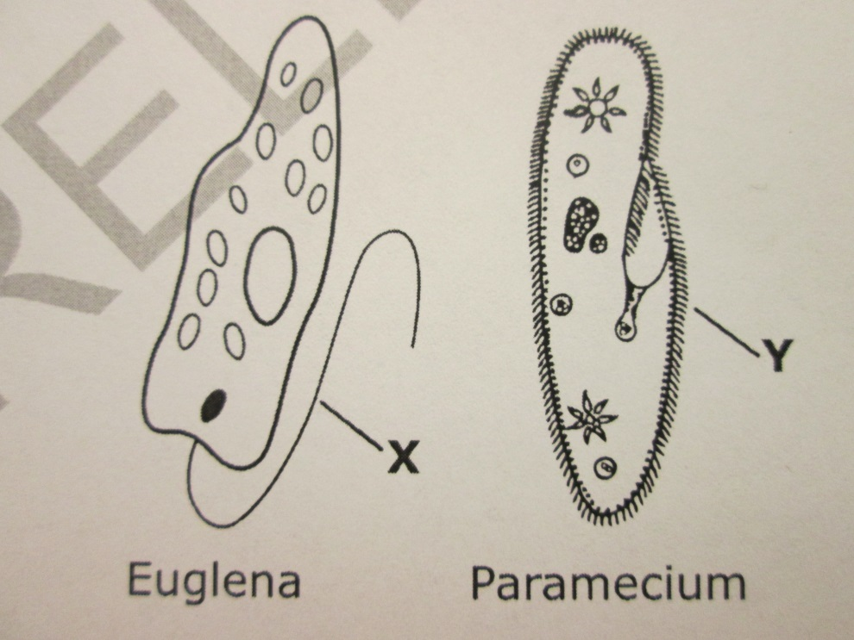
Cells & Cell Transport
21. Which function do structures X and Y have in common?
Digestion
Gathering Food
Movement
Reproduction

Slide 31
Cells & Cell Transport

Slide 32
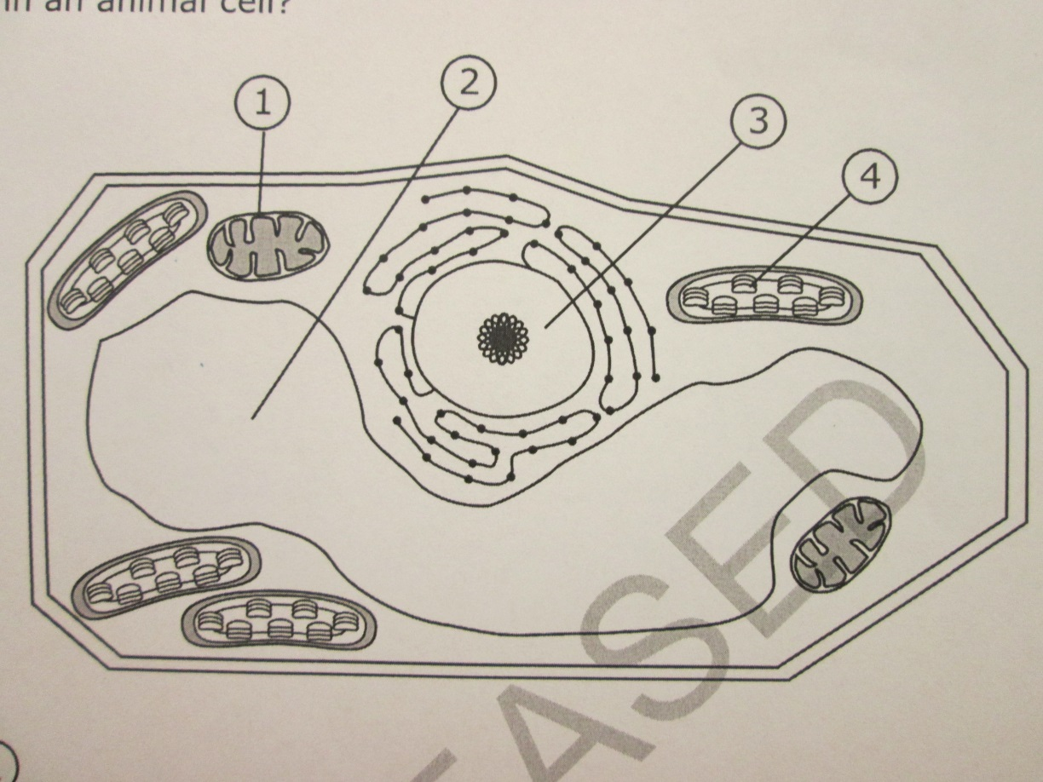
Cells & Cell transport
22. This diagram shows a plant cell. Which structure is found in a plant cell but is absent in an animal cell?
1
2
3
4

Slide 33
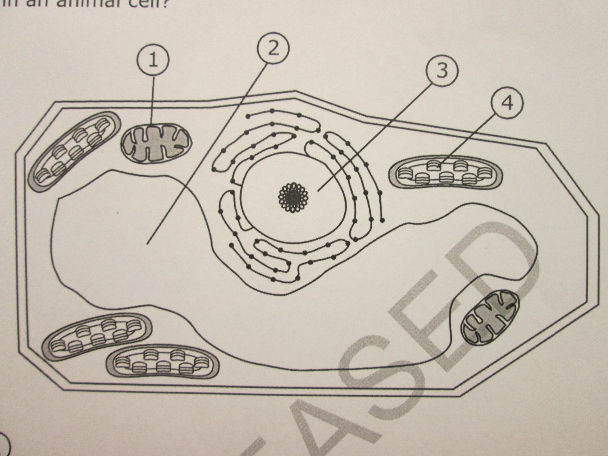
Cells & Cell transport

