Slide 1
DNA – Review Unit 4

Slide 2
DNA - Review
DNA is found inside the _________ of a cell.
What is the role of DNA in living organisms?
List the four base pairs found in DNA.

Slide 3
DNA - Review
Draw a nucleotide of DNA. Label the parts and the type of bond between two nucleotides.
Include the following parts: Phosphate Group, Nitrogen Base, Deoxyribose Sugar, Hydrogen Bond

Slide 4
DNA - Review
Fill in the Blank:
Protein Synthesis
DNA → ___ → Ribosome → ___ → ___ → TRAIT
Human Chromosome #15 holds the ____ Code to build the EYCL3 ________ which expresses the genetic trait Brown Eyes in humans.
Bank: tRNA, protein, mRNA, DNA, protein

Slide 5
DNA
1.A strand of DNA is exposed to intense heat. Which of these best describes what will happen to the strand of DNA?
The chemical bonds of the DNA molecule will be broken.
More nitrogen base pairs will add on to the DNA molecule.
The chemical bonds of the DNA molecule will be strengthened.
The nitrogen base pairs in the DNA molecule will switch places.

Slide 6
DNA
2.What is the role of hydrogen bonds in the structure of DNA?
To code for proteins
To synthesize proteins
To separate the strands
To connect the base pairs

Slide 7
DNA
3.The following cell structures are located within cells that make proteins. Which description best explains the relationship among these cell structures?
Nucleus
Ribosome
Endoplasmic Reticulum (ER)
Nucleus makes protein → protein winds through the ER → protein folds into its active shape
Nucleus directs ER to assemble the protein → ribosomes surround protein → protein folds into its active shape
ER creates protein → DNA in the nucleus codes for ribosomes to surround protein → protein folds into its active shape
DNA in nucleus codes for protein → protein assembled in ribosomes and moves to ER → protein folds into its active shape

Slide 8
DNA
4.Which of these best describes the initial change caused by a DNA mutation?
A change in the sequence of base pairs
A change in the production of enzymes
A change in the number of nucleosomes within a cell
A change in the number of hydrogen bonds between the bases

Slide 9
DNA
5.The chromosome structure in a cell accounts for genetic variation based on the order of its
Sugar groups
Nitrogen bases
Hydrogen bonds
Phosphate groups

Slide 10
DNA
6.A strand of DNA has these bases:
AGC CAT GTA TAC
What is the complementary DNA strand?
ACG GAT CTA TAG
TCG GTA CAT ATG
TGC CTA GAT ATC
UCG CUA CAU AUG

Slide 11
DNA
7.Which of these shows the steps by which proteins are coded and synthesized?
RNA→DNA→protein
DNA→RNA→protein
Protein→RNA→DNA
Protein→DNA→RNA

Slide 12
DNA
8.Which statement best describes the relationship that exists among proteins, DNA, and cells?
Proteins combine to produce cells, which produce DNA.
Proteins are made up of DNA, which determines the cells that are produced.
DNA is made up of proteins, which tell a cell how to function
Cells contain DNA, which controls the production of proteins.

Slide 13
DNA
9.What are the subunits of DNA and their function?
Nucleotides that store info
Monosaccharides that provide quick energy for the cell
Lipids that store energy and provide insulation
Proteins that provide the building blocks for the structural components of organisms.

Slide 14
DNA
10.A segment of DNA has the sequence:
ATA GCA CAT GTA
What is the mRNA sequence transcribed from the segment?
TAT CGT GTA CAT
TAT GCT CTA GAT
UAU CGU GUA CAU
UAU GCU CUA CAU

Slide 15
DNA
11.Which is a conclusion drawn from the observed DNA similarities found between apes and chimpanzees?
Apes and chimps are in the same genus.
Apes and chimps are the same species.
Apes and chimps are products of artificial selection.
Apes and chimps are thought to have evolved from a common ancestor.

Slide 16
DNA
12.Which describes the use of pieces of chromosomes to replace faulty or absent pieces that cause disease?
Karyotyping
Gene Therapy
Nondisjuntion
DNA Fingertyping

Slide 17
DNA
13.Which is common to both DNA and RNA?
Uracil
Thymine
Cytosine
Deoxyribose

Slide 18
DNA
14.Which is the complementary DNA sequence for the following segment of DNA?
CTC CAA CTA
CTG GAA CTA
GAG GTT GAT
TAT CAA GGT
GAC CTT GAT

Slide 19
DNA
15.A DNA strand with the sequences of bases shown below is transcribed to mRNA.
ATT CGA GTT
Which is the correct base sequence in mRNA?
ATT CGA GTT
TAA GCT CAA
TUU GCT CUU
UAA GCU CAA

Slide 20
DNA
16Who first proposed the double-helix structure of the DNA molecule?
Pauling
McClintock
Watson and Crick
Harris and Watkins

Slide 21
DNA
17.Which amino acids are coded for by an mRNA segment that reads CAG GUG?
Arginine and Valine
Isoleucine and Arginine
Glutamine and Valine
Valine and Isoleucine
See next slide…

Slide 22
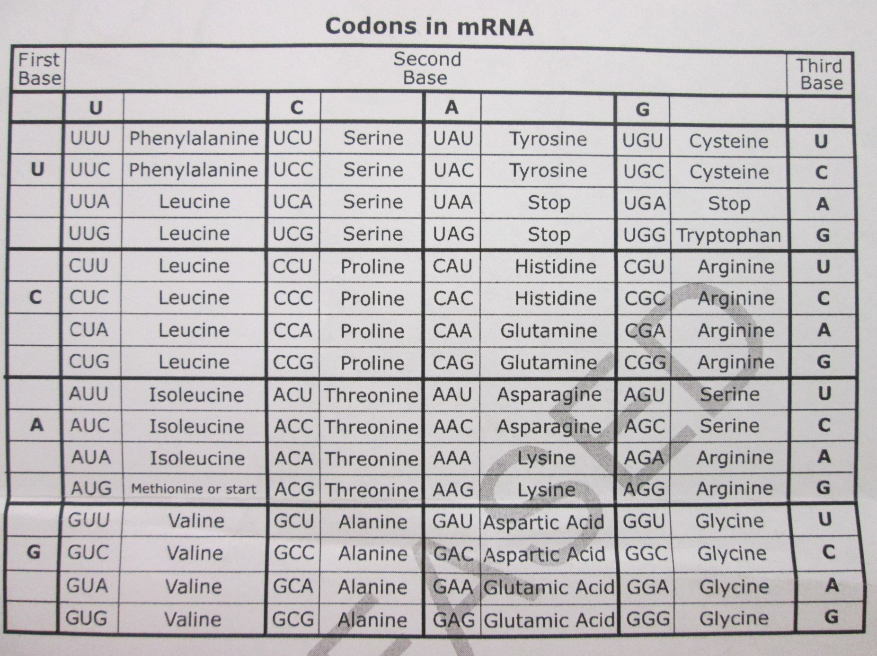
DNA

Slide 23
DNA
18.Which base sequence cannot occur in RNA?
TGCTAT
GCUAGG
CCUAAC
AAGCCC

Slide 24
DNA
19.Which factor most affects the order of amino acids in a protein?
The DNA located in the nucleus of the cell
The cell in which the protein is located
The amount of ATP available for the cell’s use
The area in a cell where proteins are produced

Slide 25
DNA
20.How does DNA code for proteins in a cell?
By creating a new double helix structure
By using its phosphate and sugar molecules
By adding more hydrogen bonds to its structure
By arranging certain nitrogen bases of the cell in a particular order

Slide 26
DNA
21.How would overexposure to X-rays affect most animal cells?
It would increase cell specialization in organs
It would change the sequence of DNA nucleotides in affected cells
It would produce new nucleotides for DNA molecules
It would cause an increase in red blood cell production

Slide 27
DNA
22.Which amino acid is specified by the mRNA code CCC?
See next slide

Slide 28
DNA

