Slide 1
Genetics – Review Unit 6

Slide 2
Genetics - Review
Explain the difference between the following terms:
Genotype – Phenotype
Homozygous – Heterozygous
Dominant – Recessive
Incomplete - Codominance

Slide 3
Genetics - Review
What is the probability that a child from a heterozygous brown-eyed man and a homozygous blue-eyed woman would have blue eyes?

Slide 4
Genetics
1.Which deals with the transmission of inherited traits from one generation to another?
Anatomy
Genetics
Ecology
Forensics

Slide 5
Genetics
2.The inheritance of short wings in Drosophila fruit flies is an x-linked, recessive trait. Which would most likely result if a short-winged female mates with a long-winged male?
All offspring will be short-winged.
All females will be long-winged, and all males will be short-winged .
All females will be short-winged, and all males will be long-winged.
Half of the males and females will be short-winged, and half will be long-winged.

Slide 6
Genetics
3.Which would most likely produce a mutation that is passed on to offspring?
Radiation changing the DNA sequence in skin cells
A gamete with an extra chromosome forming
Tobacco smoke altering the genes in lung cells
Exposure to chemicals altering nerve cell function

Slide 7
Genetics
4.A red rose bush cross-pollinates a white rose bush. The offspring have white flowers with red streaks. What type of inheritance is this?
Co-dominance
Crossing Over
Multiple Alleles
Incomplete Dominance

Slide 8
Genetics
5.Two people believe they are related. Which would be the best technique to determine if they are related?
Testing blood types
Comparing DNA
Examining Karyotypes
Testing for genetic disorders

Slide 9
Genetics
6.In a certain insect, round wings (R) are dominant to pointer wings (r). Which cross will produce the greatest number of genotypic and phenotypic variations?
rr X rr
Rr X Rr
Rr X RR
RR X RR

Slide 10
Genetics
7.A gamete has how many alleles for each gene?
1
2
3
4

Slide 11
Genetics
8Human males have
One X chromosome only
Two X chromosomes
One X and one Y chromosome
Two Y chromosomes

Slide 12
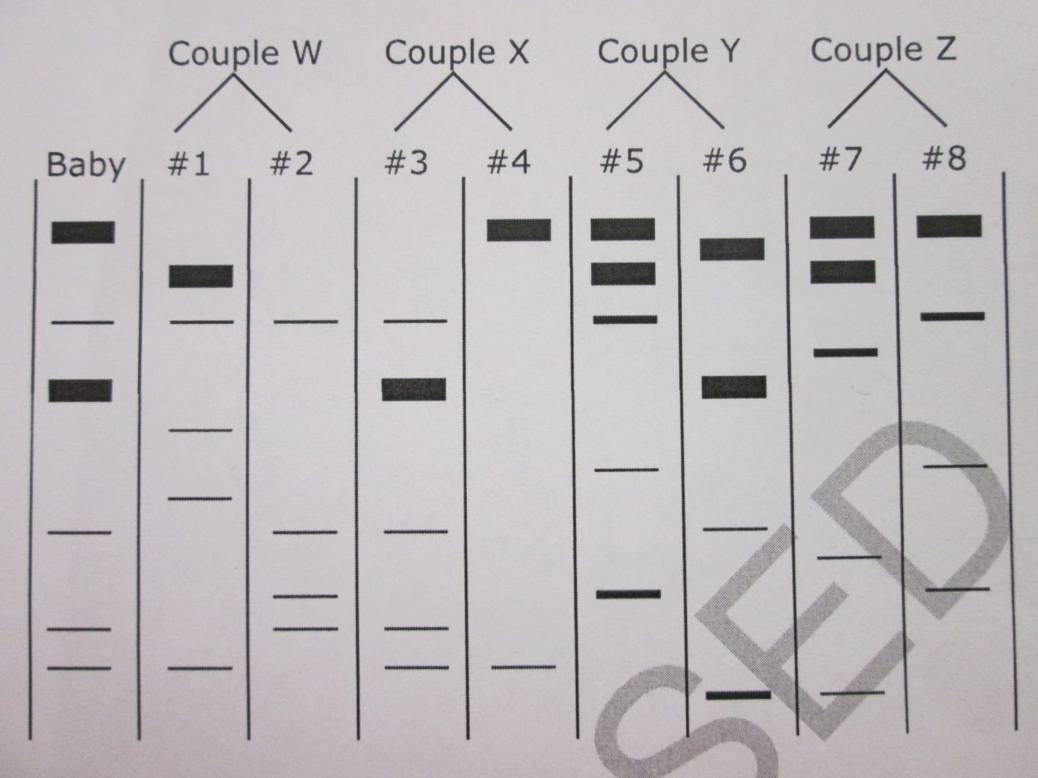
Genetics
9.A hospital wants to identify the parents of a baby. Based on the DNA fingerprints, which couple is most likely the parents of the baby?
Couple W
Couple Z
Couple Y
Couple X

Slide 13
Genetics
10.If a pea plant has a recessive allele for green peas, it will produce
Green peas if it also has a dominant allele for yellow peas
Both green peas and yellow peas if it also has a dominant allele for yellow peas
Green peas if it does not have a dominant allele for yellow peas
Yellow peas if it does not also have a dominant allele for green peas

Slide 14
Genetics
11.A tall plant (TT) is crossed with a short plant (tt). If the tall F1 pea plants are allowed to self-pollinate,
The offspring will be of medium height
All of the offspring will be tall
All of the offspring will be short
The offspring can be tall or short

Slide 15
Genetics
12.A heterozygous tall pea plant is crossed with a short plant. The probability that the offspring will be tall is
25%
50%
75%
100%

Slide 16
Genetics
13.What percentage of human sperm cells carry an X chromosome?
0%
25%
50%
100%

Slide 17
Genetics
14.Which of the following pairs of genotypes result in the same phenotype?
I^{A}I^{A} and I^{A}I^{B}
I^{B}I^{B} and I^{B}i
I^{B}I^{B} and I^{A}I^{B}
I^{B}i and ii

Slide 18
Genetics
15.Examine the pedigree below. The allele for the presence of a white forelock is dominant. What is the probability of the couple labeled 2 having a child with a white forelock?
25%
50%
75%
100%

Slide 19
Genetics
16.Situation in which one allele for a gene is not completely dominant over another allele for that gene are called
Multiple alleles
Incomplete dominance
Polygenic inheritance
Multiple genes

Slide 20
Genetics
17.A breed of chicken shows codominace for feather color. One allele codes for black feathers, another codes for white feathers. The feathers of a heterozygous chicken of this breed would be
Black
White
Speckled
Gray

Slide 21
Genetics
18.A breed of flowers shows incomplete dominance for flower color. One allele codes for red, another allele codes for white. A heterozygous plant will show what coloration?
Red
White
Pink
Red & White

Slide 22
Genetics
19.Organisms that have two identical alleles for a particular trait are said to be
Hybrid
Homozygous
Heterozygous
Dominant

Slide 23
Genetics
20.Which of the following statements is true?
Phenotype determines genotype
Genotype determines phenotype

