Slide 1
Ecology – Review Unit 7

Slide 2
Ecology - Review
Population – Community – Ecosystem
Producer – Consumer – Decomposer
Heterotroph – Autotroph
10% Rule
Succession
Parasitism – Predation
Commensalism – Mutualism
Biotic – Abiotic Factors
Exponential – Logistic Growth
Carrying Capacity
Natural Selection – Adaptation

Slide 3
Ecology
1.A rodent population leaves an ecosystem due to decreased temperatures and increased rain. Which best explains why the rodents left?
Increase in predation
Decrease in parasitism
Change in biotic factors
Change in abiotic factors

Slide 4
Ecology
2.Which completely describes the components of an ecosystem?
All the living things on Earth
A group of populations living in one area
A community of organisms and their physical environment
All the organisms of one species that live together and interbreed

Slide 5
Ecology
3.Which is the greatest threat to biodiversity?
Hunting and fishing without a license
Introducing non-native species into a habitat
Growing flowers and vegetables in a home garden
Increasing the amount of land set aside for conservation

Slide 6
Ecology
4.A deer tick feeds on the blood of a host and can transmit bacteria that can cause disease. The deer tick and the host are an example of what type of symbiotic relationship?
Predation
Parasitism
Mutualism
Commensalism

Slide 7
Ecology
5.Which is a contributor to a decrease in biodiversity?
Wetlands
Use of alternative fuels
Human population growth
Formation of nature preserves

Slide 8
Ecology
6.Malaria causes over one million deaths per year. The disease is transmitted by female mosquitoes carrying the protist Plasmodium.
Why was it important for scientists to discover the cause of this disease?
To develop a more effective means of prevention
To fully describe the symptoms seen in the patients
To accurately estimate the number of people affected
To determine the areas of the world where the infections occur

Slide 9
Ecology
7.According to natural selection, which of the following results would be considered a beneficial mutation to an organism?
Resistance to a virus
Formation of cancer cells
Inability to undergo sexual reproduction
Stopping the production of an essential protein

Slide 10
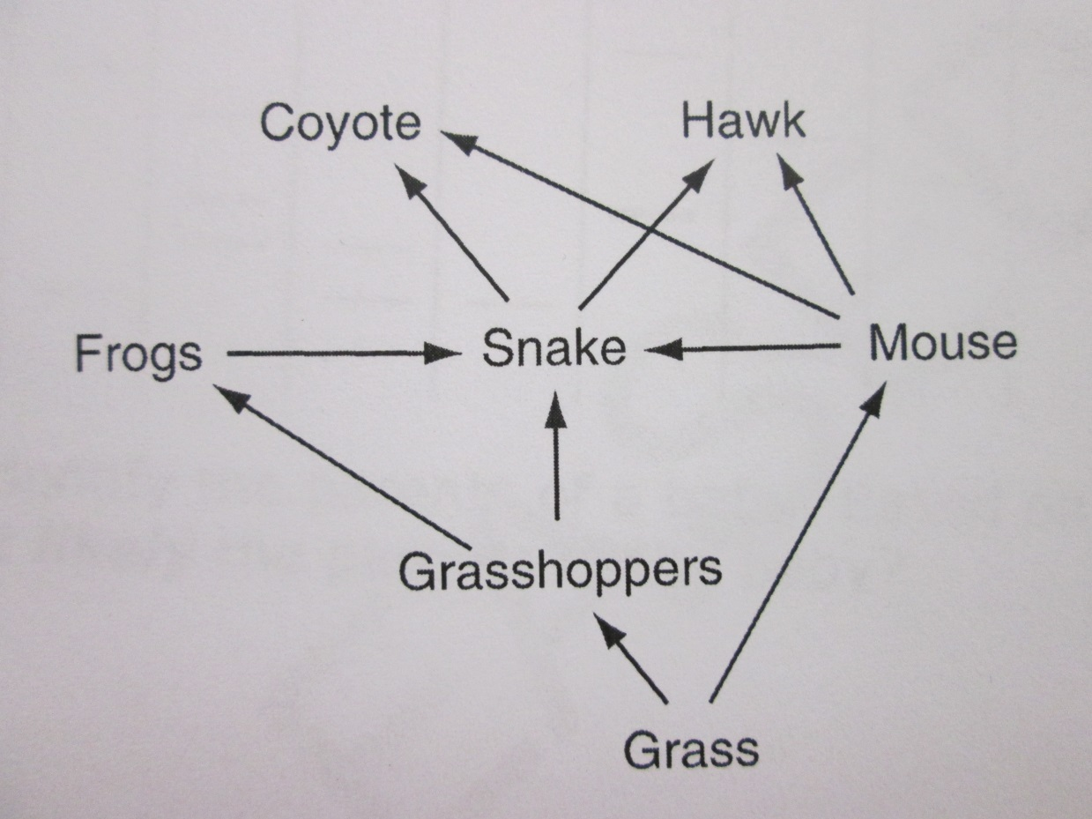
Ecology
8.A reduction in which of these would lead to a decrease in all the other populations in the web?
Coyote
Grass
Grasshoppers
Snake

Slide 11
Ecology
9.The gopher snake uses its glottis to produce a hiss that sounds similar to a rattlesnake’s rattle. What is the most likely reason a gopher snake would do this?
To attract prey
To attract a mate
To confuse predators
To increase adrenaline flow

Slide 12
Ecology
10.A population of salamanders that live in a river require clear, fresh water to survive. A flood causes tons of sediment to be suspended in the water. Which of these most likely will happen to the salamander population?
The salamanders will adapt to life on land.
The salamanders will move to another river.
The salamanders will adapt to living in the muddy water.
The salamanders will decrease in number because of the water quality.

Slide 13
Ecology
11.The papaya mealybug is a pest that poses a threat to many tropical plants. Which fate of the mealybug would result from the inability of the species to reproduce
The species would mutate.
The species would increase.
The species would become extinct.
The species would continue to thrive.

Slide 14
Ecology
12.Polar bears swim across large expanses of ocean while hunting for seals, their main source of food. The bears use sea ice as resting spots during their long swims. However, the sea ice is rapidly melting as a result of global warming. Which statement describes what most likely will happen if global warming continues at its present rate?
Polar bear and seal populations will both increase.
Polar bear populations will decrease, and seal populations will increase.
Polar bear populations will increase, and seal populations will decrease.
Polar bear populations will decrease, and seal populations will remain the same.

Slide 15
Ecology
13.The loss of habitat in a forest region has caused some plant species to become extinct, while others survive. The process by which some plant species survive and others do not in a changing environment is best explained by
Natural selection
Law of segregation
Biological magnification
Alternation of generations

Slide 16
Ecology
14.A forest fire destroys the majority of the trees in a state park. Which effect will this most likely have on secondary consumers in that ecosystem?
The amount of available energy will increase because there will be fewer predators in the forest.
The amount of available energy will increase because there will be less competition from producers.
The amount of available energy will decrease because fewer primary consumers will survive the lack of vegetation.
The amount of available energy will remain constant because secondary consumers are not reliant on primary consumers.

Slide 17
15.A new species of snake was introduced to a tropical region. Scientists then noticed a steady decline in the presence of field mice and an increase in the number of snakes. Which of these is the most likely explanation about why the population size of each animal changed?
The snakes introduced to the region dominated the habitat, forcing the mice to find another place to live.
The mice became prey to the introduced snakes, allowing the snake population to increase but decreasing the mice population.
The snakes introduced to the region competed with the mice for food, allowing the snake population to increase but decreasing the mice population.
The people in the surrounding area set traps that killed the mice, allowing the snakes to live without any predators and therefore to increase in number.

Slide 18
Ecology
16.Which of these best describes mutualism?
A relationship between two species where both species benefit.
A relationship between two species where neither species benefits
A relationship between two species where one species benefits and the other is not affected
A relationship between two species where one species benefits and the other species is harmed

Slide 19
Ecology
17.Which abiotic factor limits the altitude at which plants can grow?
The presence of a parasite
The temperature of the area
The presence of herbivorous animals
The concentration of microbes in the soil

Slide 20
Ecology
18.One species of Galapagos finches, the cactus finch, eats insects off cactus plants. A disease kill off most of the cacti in the Galapagos Islands. Which of these most likely would happen to the carrying capacity of the island?
It would increase a small amount since the insect population would decrease.
It would remain about the same since the finches would change to a different diet.
It would increase exponentially since the insects would have limited places to hide.
It would decrease considerably since the finches are specifically adapted to their niche.

Slide 21
Ecology
19.What is the function of autotrophs in the carbon cycle?
To use oxygen to produce glucose
To take in excess water
To use carbon dioxide to produce glucose
To feed on herbivores

Slide 22
Ecology
20.Two different populations of birds live in the same area and eat the same types of food. Which most likely describes the relationship between these two populations of birds?
Competition
Mutualism
Parasitism
Predator- Prey

Slide 23
Ecology
21.Which will most likely cause variation to occur within a species?
Competition
Mutation
Mutualism
Predation

Slide 24
Ecology
22.The loulu tree in Hawaii reproduces by a seed encased in a fruit. Non-native species, such as pigs and rats, eat the fruit as a regular part of their diet, drastically reducing the regeneration rate of the loulu. What most likely would be the outcome for loulu trees in the next century without intervention?
They would become extinct.
They would rebound and thrive.
They would remain at their current levels.
They would evolve a new way to reproduce.

Slide 25
Ecology
23.What will most likely happen if the human population continues to grow at current rates?
There will be fewer natural resources available for future generations.
There will be an increase in nitrogen levels in the atmosphere.
There will be a decrease in water pollution.
There will be an increase in the number of strong hurricanes.

Slide 26
Ecology
24. if worldwide deforestation is not regulated, what could most likely result?
Acid rain could lower the pH of rivers and lakes to dangerous levels for aquatic life.
CO2 levels in the atmosphere could increase and contribute to global warming problems.
Plants and animals could become better adapted to living in desert conditions.
Future generations of humans could have an excess of wood and paper products.

Slide 27
Ecology
25.A field ecologist wants to determine the interactions of various populations of organisms living in large grassland field. Which method is best for conducting this study?
Consulting with local farmers about the diversity of organisms in the field
Dividing the field in half, walking over it, counting organisms, and then doubling the numbers
Walking over the entire field, collecting the organisms, and them compiling a total
Observing the behaviors of different types of organisms several times during the year

Slide 28
Ecology
26.A large population of cockroaches was sprayed with an insecticide. A few of the cockroaches survived and produced a population of cockroaches that was resistant to this spray. What can best be inferred from this example?
A species will adapt no matter what the environment.
The environment has no effect on the survival of an organism.
Insecticides cause mutations that are passed on to the next generation.
Individuals with favorable variations survive and reproduce.

Slide 29
Ecology
27.The yucca plant releases a strong scent at night when the yucca moth is active. The yucca moth, attracted by the scent, gathers pollen from the yucca flower. The yucca moth the deposits her eggs and the pollen on another plant. This ensures that the plant will be cross-pollinated and that the yucca moth larvae have a steady food supply. Which relationship does this best illustrate?
Commensalism
Mutualism
Parasitism
Predation

Slide 30
Ecology
28.The males of a bird species do a “dance” and “sing a song” each spring. What is the main purpose of these behaviors?
To scare off young birds
To imprint young birds
To clean their feathers
To attract female birds

