Slide 1
Performance Event
Biology Performance Event
Scientific Method
Review

Slide 2
Independent vs. dependent variables
INDEPENDENT VARIABLE
What “I” change
The variable that is MANIPULATED by the SCIENTIST
DEPENDENT VARIABLE
What is MEASURED
The variable that changes IN RESPONSE to the independent variable

Slide 3
Testable question
After you are given a “scenario,” they may ask you to write a “testable question.”
A testable question IS NOT A HYPOTHESIS
What question do you want answered?
Comes BEFORE the hypothesis.
SIMILAR to hypothesis BUT formed as a question.
DOES CHANGING _IV__ HAVE AN EFFECT ON _DV__?

Slide 4
HYPOTHESIS
Review:
The scientists PREDICTION prior to EXPERIMENTATION
IF THE _IV_ IS _CHANGED_,
THEN THE _DV_ WILL _CHANGE_.

Slide 5
CONSTANTS
VARIABLES KEPT CONSTANT
Any variables OTHER THAN the IV and DV must all be kept the same.
Can only change 1 variable at a time.
If testing sunlight and height of plant, what would be your constants?
Soil, temperature, water, type of seed, size of container, etc.

Slide 6
equipment
What type of equipment would be needed for an investigation?
Visualize the experiment in your mind.
What “stuff” will you need?
Equipment NOT supplies
Examples:
Beaker, lamp (light source), thermometer, stop watch, test tube, tray, bucket

Slide 7
procedure
You will be asked to write a procedure for your experiment
3 STEPS
Step 1: Set It Up:
Use ONE step to set up your experiment. BE THOROUGH!!!
Place 50 g of dry Miracle Grow soil in a 1000mL beaker. Place 1 tomato seed approximately 2cm below the surface of the soil. Water with 50 mL tap water.

Slide 8
procedure
3 STEPS
Step 2: Independent Variable
Use Step 2 to change your IV. BE THOROUGH!!!
Place beaker with planted seed at a distance of 20 cm from light source. Add 25 mL of water once a week. Measure height of seedling once a week. Allow to grow for 12 weeks.

Slide 9
procedure
3 STEPS
Step 3: Repeat!
Use Step 3 to take care of the rest of your IV. BE THOROUGH!!!
Repeat step 2 for the following distances: 40cm from light source, 60cm from light source, 80 cm from light source.

Slide 10
Conclusions
Always either “SUPPORT” or “REFUTE” the hypothesis
You can NOT prove anything with 1 experiment
Sometimes data is not clear one way or another
Said to be “INCONCLUSIVE”
Cannot support or refute hypothesis based on inconclusive data

Slide 11
Conclusions
Should always start with
Based on the data…
According to the data…
Based on the data, the hypothesis was SUPPORTED/REFUTED.
The hypothesis was neither supported or refuted due to the fact that the data was INCONCLUSIVE.

Slide 12
graphing
INDEPENDENT VARIABLE
ALWAYS GOES ON THE X-AXIS
What I change goes across the bottom
DEPENDENT VARIABLE
ALWAYS GOES ON THE Y-AXIS
What is measured goes on the side

Slide 13
Title
Always capitalized like the title of a book
The Effect of IV on DV
Written Correctly:
The Effect of the Amount of Sunlight on the Height of Plants

Slide 14
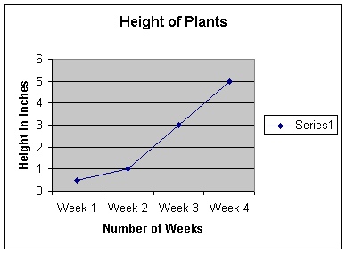
graphing
TITLE of Graph
2. Both axis are LABELED WITH UNITS
3. Both axis use EVEN SCALES
4. Data points are PLOTTED
5. Line is DRAWN between data points

Slide 15
Example #1
CO2 consumed (micromoles per square meter per second) | Light intensity (photons per square meter per second)
0 | 0
7 | 200
13 | 400
16 | 600
16.5 | 800
16.75 | 1000
A student was investigating the effect of light intensity on the rate of photosynthesis. To do this, the student manipulated the light intensity for different trials and measured the amount of CO2 consumed by the plant. The results of the experiment are shown in the table to the right.

Slide 16
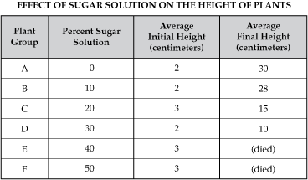
Example #2
Two students were investigating how a sugar solution would effect the height of growing plants. The students added varying levels, measured in percentages, to the water that was being given to the growing plants. The data from the experiment is listed at the table to the right.

Slide 18
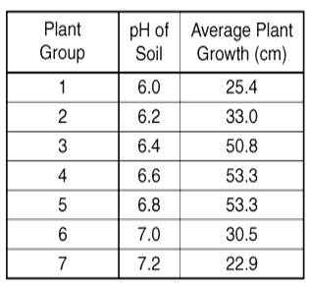
Example #3
Two students were investigating how the pH of the soil would effect the height of growing plants. The students altered the pH of the soil and measured the average growth of the plants. The data from the experiment is listed at the table to the right.

Slide 20
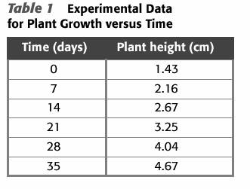
Example #4

